Slide 1
Data compass
Enterprise RAG
ATMECS Global X Hacker Earth

Slide 2
AGENDA
Problem Statement
Solution Overview
Architecture
Technical Overview
Future Roadmap
Summary

Slide 3
Problem statement

Slide 4
In the landscape of Data Science, managing large sets of data often requires complex solutions like Databricks and other big data architectures. But are these solutions affordable and accessible for mid and small-scale users? Do they provide a fast, simple way to explore insights without significant investment?
What if there was an easier way? What if all the information you needed was just a chat away, without the need for complex setups or high costs? Could there be a tool that not only assists you with data science tasks but also helps you make sense of your business in seconds?
Imagine a solution that's not just about Data Science but goes beyond—where every task, every query, and every piece of data you need is instantly accessible. This is the vision of DataCompass: to simplify, explore, and redefine what’s possible. Are you ready to discover more?

Slide 5
SOLUTION OVERVIEW
AskMe Chat
Insight Extractor
Data Genie
Instant Answers: Get quick responses to general questions.
Conversational AI: Chat naturally to explore any topic.
Guidance & Advice: Receive suggestions and actionable tips.
Contextual Understanding: Gain a deeper understanding of your data with contextual responses.
Summarize Content: Quickly condense lengthy documents into concise summaries.
Data-Driven Answers: Get accurate, data-backed answers to specific questions from your files.
Ask Your Data: Query databases or Excel files instantly.
Auto SQL & Results: Generate and run SQL with ease.
Instant Visuals: Create charts and graphs effortlessly.
*Titles might vary in the App

Slide 6
Hold on!
There is plenty more to it.
Want to tweak some settings? We’ve got you covered with advanced settings.
Additionally, if time persists we will release a few usecase specific micro apps.

Slide 7
ARCHITECTURE

Slide 8
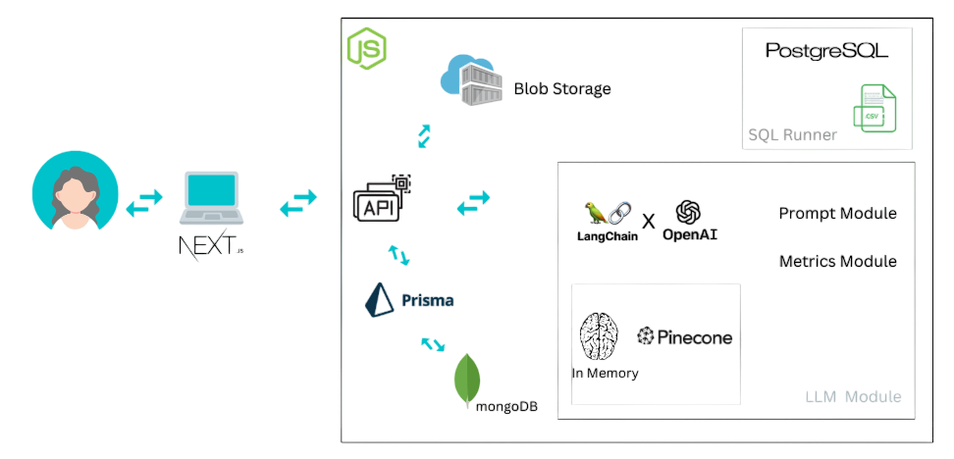

Slide 9
User journeys
Navigating with DataCompass

Slide 10
User selects “Askme chat”, can interact with the LLM as a normal chat with casual uses. With added features like, [1] users could set / modify prompt. [2] Temperature tuning. [3] Contextual Awareness. [4] Voice Search [5] Multi LLM model switch on a same chat. Eg: you can ask a followup on a response given by GPT 3.5 with GPT 4 and vice versa. Based on how many models are feasible to add.

Slide 11
User selects “INSIGHT EXTRACTOR”, can interact with the LLM as normal chat as well as upload files and extract valuable insights from it. With added features like, [1] upload File supports (pdf, word, txt, jpg, png, jpeg) [2] user can select NO RAG / in memory RAG / connect to external RAG. ( no rag for small instant chat cases, in memory for querying on uploaded files only, external to query over already chunked large collection of data). [3] Image explanation / text extractions. Enabled with GPT-4-vision. [4] all chats will be saved in Databases and users will be able to circle back and do followups. In case of RAG / any uploaded contents, embedding memory vectors or the files will be stored.

Slide 12
User selects “DATA GENIE”, can interact with the LLM as which is tuned for data processing & UI interface to query, run and visualize data. With added features like, [1] users can upload Excel files and ask questions on top of it. Generate insights, tables and graphs on the fly. [2] Connect your databases, point it to a table and start asking questions, ask model to generate SQL Queries, if you are ok with the queries you can run then and see the results in table. Need a graph for table? On click of a button the model will create a graph based on the result data in seconds. [3] All connected Databases, API keys and Vector Database keys and created prompts can be managed in the settings.

Slide 13
Technical overview
frontend
backend
Next.js – its is just a choice. since its comes with inbuilt api securities.
ANTD – component design framework
Redux-toolkit – State Management
Follows HEXBANE’s architecture (* still under progress). Built by Shivaraj [team lead]. The goal is to speed up the application development process. Github Link
and other general libraries.
Next.js (node.js)
Prisma ORM
MongoDB – its free and it seems to a right choice for this type of data.
Blob storage
and other general libraries.

Slide 14
Technical overview
GEN.Ai
RAG
Langchain
Azure GPT embeddings
Azure GPT-4-Vision
Azure GPT 3.5 and GPT 4 - If time persists we will add multi LLM model switch to dynamically switch between multiple model. this also depends on our budget constraints.
In_Memory RAG: quick and easy way for few documents / smaller level of data.
Pinecone RAG
If time persists more RAG options will be enabled.

Slide 15


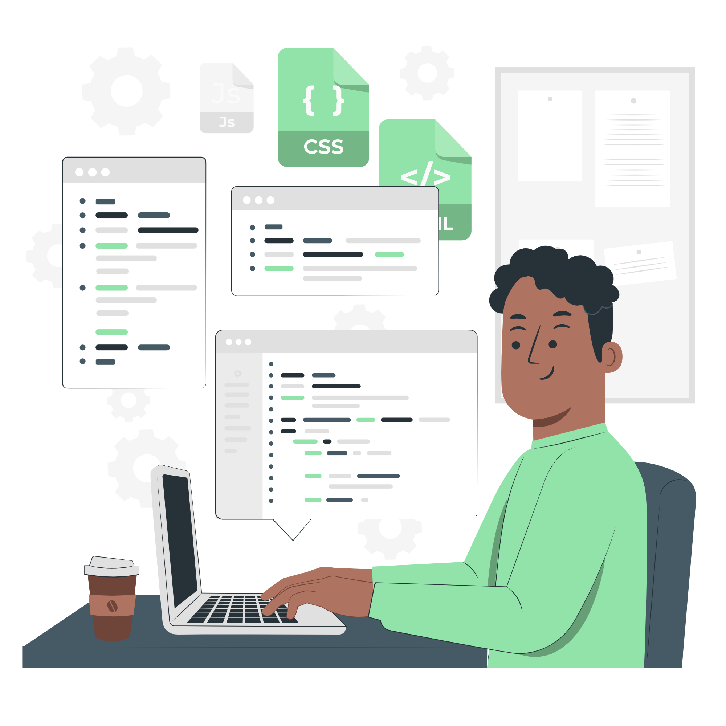
MEET OUR TEAM
SHIVARAJ S
KISHORE TS
MOHAMMED UVAIS
Dev Sorcerer
Orchestrates the entire app development, from backend logic to front-end magic.
Experience Alchemist
Crafts engaging user journeys, blending design and functionality seamlessly.
Data Whisperer
Tames and integrates data, ensuring it speaks perfectly with the LLM.

Slide 16
Future Roadmap
Introduce more models support.
Exploration on usage on ‘more than a chat interface’.
Explore Agents to integrate other services to expand the capabilities
Llm models
usage
agents
Create more usecase specific micro apps
Cost reduction strategies and more
enhancement
More apps

Slide 17
Do not wait to strike till the iron is hot, but make it hot by striking
“
”
William Butler Yeats

Slide 18
SUMMARY
DataCompass is set to revolutionize the data landscape by transforming how users interact with and derive insights from their data. By seamlessly integrating advanced AI with user-friendly interfaces, DataCompass empowers users to unlock the full potential of their data effortlessly.
Our tool democratizes access to powerful data analysis and visualization capabilities, making sophisticated insights accessible to everyone, regardless of their technical expertise. With continuous innovation and a commitment to expanding features throughout the hackathon, DataCompass is not just a tool but a game-changer in data interaction—enabling smarter, faster decision-making and setting a new standard in the industry.

Slide 19
THANK YOU
Team Data Compass

